Slide 1
Operating system Lecture eleven
Dr jamal altuwaijari

Slide 2
10.7 locality
To prevent thrashing we must provide a process with as many frames as it
Needs .But how do we know how many frames it needs? There are several
Techniques .
The working set strategy start by looking at what a program is actually using.
This approach defines the locality mode of program execution. The locality
model states that as a program executes it moves from locality to locality.
A locality is a set of pages which are actively used together.
If the O/S allocate fewer frames than the size of the current locality the process
Will thrash.

Slide 3
10.8 Working Set Model
The working set model is based on the assumption of locality. This model uses
a parameter $∆$ .To define the working set window .
The idea is to examine the most recent $∆$ page references. The set of page in $∆$
Is the working set.
If a page is in active use it will be in the working set. If it is no longer being it
Will drop from the working set $∆$ time units after its last reference.
Thus the working set is an approximation of the program locality.
Example:
Given the sequence of memory references shown in figure below if $∆$=10
Memory references then the working set at time t1 is {1,2,5,6,7}.
By t2 the working set has changed to {3,4}.
Page reference trace
… 2 6 1 5 7 7 7 7 5 1 6 2 3 4 1 2 3 4 4 4 3 4 3 4 4 4 1 3 2 3 4 4 4 3 4 4 4 …

Slide 4
wS(t1)={1,2,5,6,7} WS(t2)={3,4}
Figure 11.1 working set model
The accuracy of WS depends upon the selection of $∆$ . If it is too small it will not
Provide the entire WS. If it is too large it may overlap several localities.
$∆$ is infimite the WS is the entire program.
The most important property of the WS is its size . If we compute the WS size
WSSi for each process in the system we can then consider.
D= WSSi where D is the total for frames. Each process is actively using the
Pages in its WS. Thus process I needs WSSi frames if the total demond is
greater than the total number of available frames thrashing will occur since
some processes will not have enough processes.
The use of WS model is then quite simple. The O/S monitor the WS for each
Process and allocates to it enough frames. The WS strategy prevents thrashing .
We can use a reference bits for each page with a fixed interval timer interrupt to
approximate the WS .

Slide 5
10.9 Page Size
There is single best page size where are a set of factors which suppent
Various sizes.
Page size are in variable powers of two geneally ranging from 256($2^{8 })$
Bytes or words. To 4096 ($2^{12 })$
How do we select a page size ?
a. One factor is the size of the page table where decreasing the page size increases the number of pages and hence the size of page table.
b. Small page size minimize the internal fragmentation .
c. Large page size minimize the I/O time.
d. A small page size allows each page to better match program locality.
e. Small page size increase the number of page faults .

Slide 6
Careful selection of data structures and program structure can increase locality and hence lower the page fault rate and the number of pages in working set.
Example:
Assume page are 128 words in size consider a Pascal program with a 128 by128 array to initialize to zero . The following code is topic var A: array [1...128] of array [1…..128] of integers.
For j:=1 to 128 for I:= 1 to 128
Do for I:= 1 to 128 Do for j:= 1 to 128
, Do A[I] [j] :=$∅$ ; Do A[I] [j] :=$∅$
Number of page Number of page fault
Fault 128*128=16384 128

Slide 7
11.Disk Scheduling Algorithm
Each disk had a flat circular shape. Its two surfaces are covered with a magnetic
material. Information is recorded on the surfaces.
When the disks is in use a drive motor spins it at high speed (for example 3600
R/M) , there is a read/write head positioned just above the surface of the disk.
The disk surface is logically divided into tracks.
Information is stored by recordiong it magnetically on the track under the read/write
Head.
There may be hundred of tracks on a disk surface. A fixed-head disk has a
Separate head for each track. This arrangement allows the computer to switch
From track to track quickly.
The physical model of the memory-head disk as in the figure 11.1
Disk speed is composed of three parts:

Slide 8
Move the head to appropriate track.
2.Latency time : the wait time until
the desired block rotates under the
read/write head .
3.Transfer time : The actual transfer of
data between the disk and main memory.
The total time to service a disk request = seek time +latency time +transfer time.
When a process needs I/O to or from the disk it issues a system call to the O/S.
The request specifies several pieces of necessary information :
1.IS this as input or output operation ?
2. The disk address (drive , cylinder ,surface ,block) .
3. The memory address.
4. The amount of information to be transferred (a byte or word count ).
There are many disk scheduling algorithms :
1.First – come - First – served scheduling (FCFS).
This Alg . Is easy to program and fair , it may not provide the best ( average) service.

Slide 9
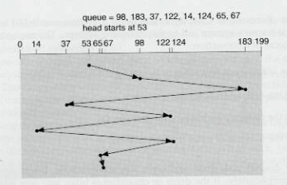
Example
Consider an ordered disk queue with requerts involving tracks:
98,183,37,122,14,124,65, and 67 if read/write head is initially at track 53, the
Schedule is diagrammed in the following figure.
Queue =98,183,37,122,14,124,65,67
The total head Movement =640 Tracks Figure 11.2 FCFS Disk scheduling

Slide 10
2. Shortest – seek – Time First (SSTF)
Together before moving the head for a way to service another requests
SSTF selects the request with minimum seek time from the current head position.
In our example request queue the closed request to the initial head position(53) is
At track 65 , the next closest request at track 67 and so on.
See the figure 11.3 below .

Slide 11
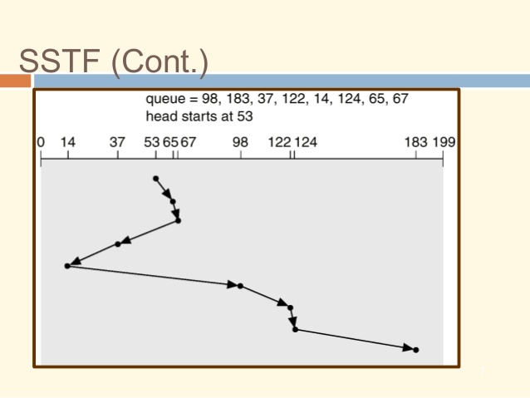
Figure 11.3 the SSTF scheduling Alg.
The total head movement =236
This alg would result in a substantial improvement in average disk service . it is
Better than FCFS.

Slide 12
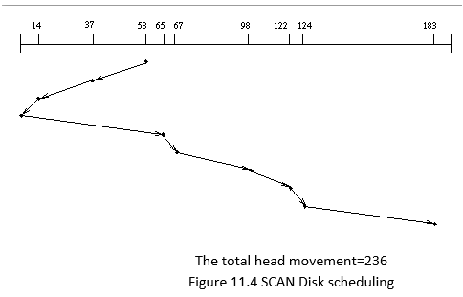
3.SCAN
The read/write head starts at one end of the disk and moves to word the other end,
Serving requests as it reaches each track until it gets to the other end the disk. At
the other end the direction of head movement is reversed and servicing continues.
The SCAN Alg .Called elevator Alg .
Before applying SCAN to our example we need to know the direction of head
movement in addition to its last position.
If the head was moving toward Q, the head movement would service 37 and 14 as
It moved to Q. At track Q the head servicing the requests 65,67,98,122,124, and
183 see the figure 11.4.

Slide 13
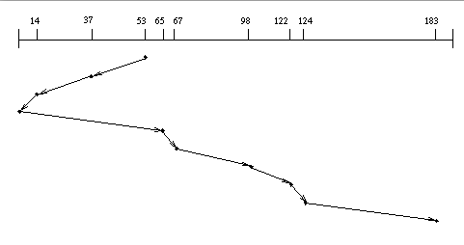
4.C-SCAN
If is a circular – SCAN designed to provide a more uniform wait time .As with
SCAN moves the head from one end to other servicing requests as it goes.
When it reaches the other end it immediately return to the beginning of the disk
Without servicing any requests on the return trip.
C-SCAN treats the disk as if it were circular with see the last track adjacent to the
first one . see the figure 11.5
Queue=98,183,37,122,14,124,65,67 head position at 53
C-SCAN

Slide 14
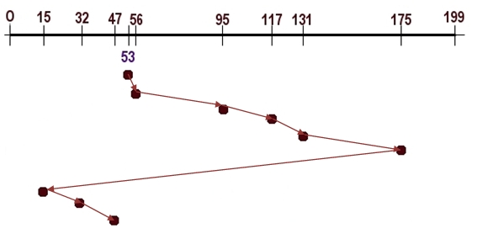
C-LOOK
Figure 11.5
More commonly the head is only moved as for as the last request in each direction . As
Soon as no requests in the current direction the head movement is reversed.
These version of SCAN and C-SCAN are called LOOK and C-LOOK (look for a
Request before moving in that direction . See figure above .

